Slide 2
CONTENT
Trying to present our knowledge of English and encourage other pupils to start learning it by showing that this language is far more than just a grammar and texts that we are doing on classes, we decided to create this magazine to prove that English can be fun. So, enjoy reading it and if you have any suggestions we would be happy to listen to them and input them into our project.
Thanks and happy reading. ☺
Music - Rihanna……..........System of a down………..EKV
Entertainment - Funny English……….. Jokes……………. facts or fiction
Interviews - Math Teacher …………English Teacher
Film - Hancock…… The Fourth Man......Desperate housewives
Sport - Introduction………….. Michael Phelps
My favourite instruments - Violin
Funny Horoscope - read about your future
Paparazzo - Teachers of Serbian and Physics
Don’t be lazy be popular - be part of a team “Sweet Years”

Slide 3
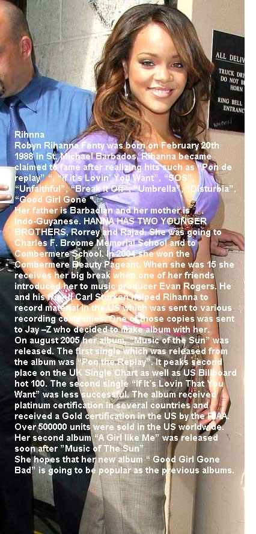
Music: art that makes our souls bloom
Rihanna has teamed up with H&M and other celebrities
like Timbaland and Good Charlotte for "Fashion
against AIDS".
The collection is designed to spread awareness
about HIV/AIDS. It was released at H&M
in early February 2008.[26] She went
on the Glow in the Dark Tour with Kanye West,
Lupe Fiasco, and N.E.R.D.[27]
There are conflicting reports about her next album.
MTV.com reported that Rihanna has now gone
into the studio to start recording her fourth album,[28]
but
on the Ryan Seacrest show Rihanna said
"I am not in the studio yet,
Not yet no, We're not gonna have an album out this year,
probably the top of next year in 2009."
In the near future, Rihanna is scheduled to work with
Ryan Tedder who named her as 'The Next Britney'.[29]
Rihanna will be a godmother of the eight season
of Star Academy France.[30]
Translated by Dragica and Branka VII 5

Slide 4
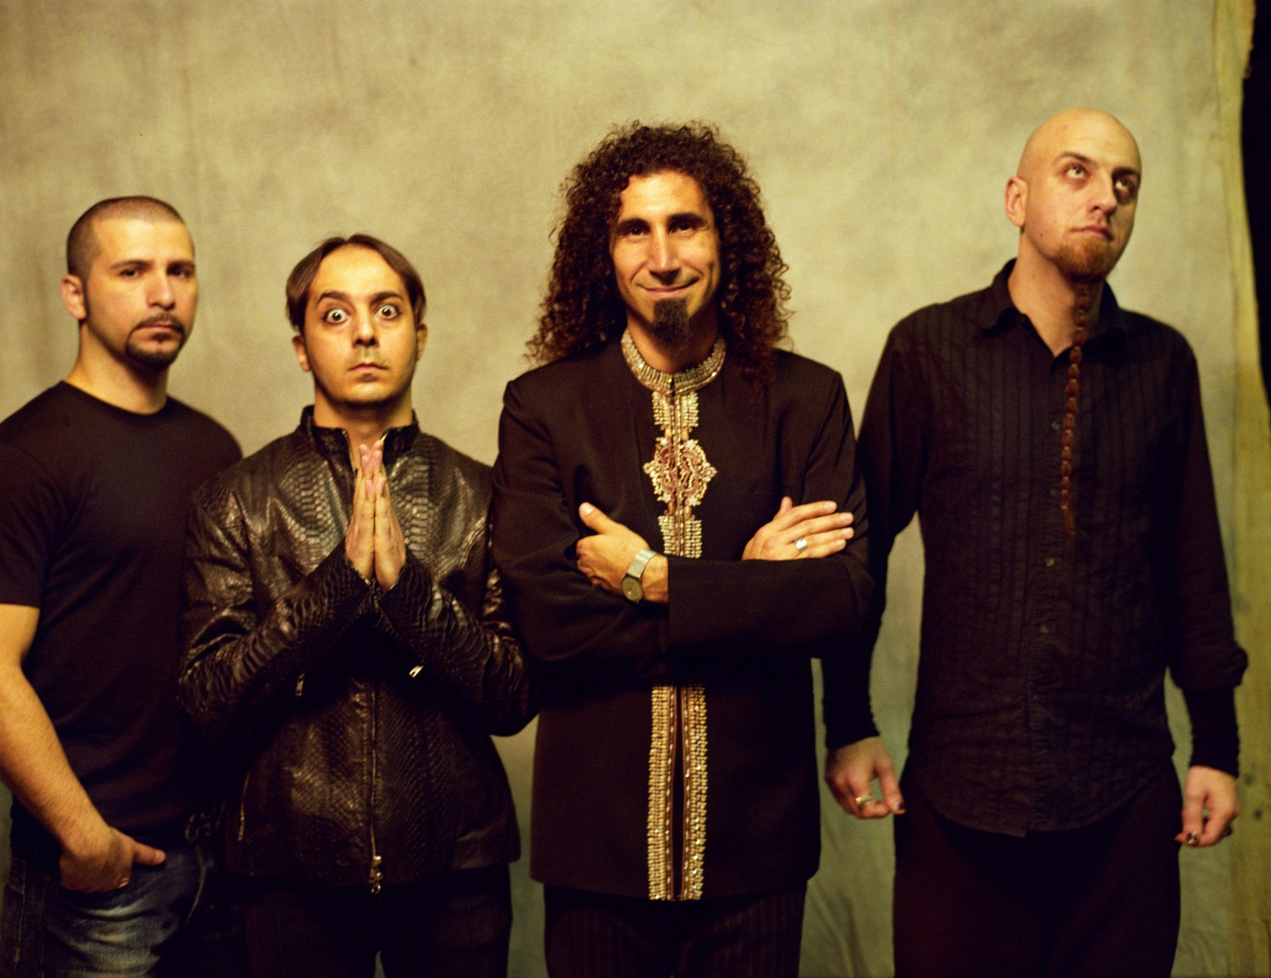
System Of A Down-SOAD is Californian gang, formed 1994. Songs of SOAD are mix of metal nu metal hardcore and Armenian music. SOAD are : Serj Tankian (vocal,keyboard and guitar), Daron Malakian (guitar and vocal), - Shavarsh "Shavo" Odadjian (bass) and John Dolmayan (drums).Their albums are System of a Down(1998), Toxicity(2001), Steal This Album!(2002), Mezmerize(2005) and Hypnotize(2005).SOAD-s best songs are B.Y.O.B.( Bring Your Own Bombs) and 'Chop Suey.

Slide 5
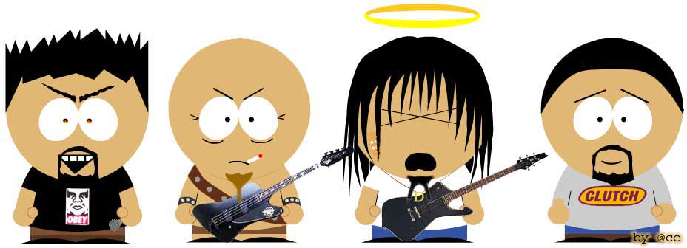
CHOP SUEY Advertising's got you on the run, Advertising's got you on the run. What a splendid pie, Pizza-pizza pie, Every minute, every second, Buy, buy, buy, buy, buy, What a splendid pie, Pizza-pizza pie, Every minute, every second, Buy, buy, buy, buy, buy. Pepperoni and green peppers Mushrooms, olive, chives, Pepperoni and green peppers Mushrooms, olive, chives. Need therapy, therapy, Advertising causes need, Therapy, therapy, Advertising causes need, Therapy, therapy, Advertising causes need, Therapy, therapy, Advertising causes need Pepperoni and green peppers Mushrooms, olive, chives. Need therapy, therapy, Advertising causes need, Therapy, therapy, Advertising causes need, Therapy, therapy, Advertising causes need, Therapy, therapy, Advertising causes need, Therapy, therapy, Advertising causes need, Therapy, therapy, Advertising causes need. Well advertising's got you on the run, Need therapy, therapy advertising causes, Well advertising's got you on the run, Need therapy, therapy advertising causes, Well advertising's got you on the run, Advertising's got you on the run, Advertising's got you on the run, Advertising's got you on the run, Advertising's got you on the run, written by Sara VII5

Slide 6
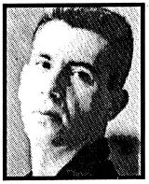
EKV-Ekatarina Velika
Music of EKV is a mix of new wave and Rock music. EKV were :Milan Mladenovic(guitar, vocal),Margarita Magi Stefanovic(keyboard, vocal),Bojan Pecar(bass) and Srdjan Zika Todorovic(drums). First name of band was Katarina II,because first Milan`s love was one Katarina. Their albums are: KATARINA II,EKATARINA VELIKA (when they changed name in EKV-EKatarina Velika),S VETROM U LICE,LJUBAV,PAR GODINA ZA NAS,DUM-DUM and NEKO NAS POSMATRA.EKV was the most famous band in south Europe, but their lives went too early on other side as in a song of RHCP “Other side” After their last concert Milan felt something strange in his stomach and he had to go to hospital. The doctors discovered one really bad thing. , Milan had a cancer! After 3 months Milan died.
Magi die on September 18 2002. in a center for people who don’t have anywhere to live! She was the best player of piano and keyboards and I can`t believe where she die! Unfortunately she overdosed herself. Bojan Pecar die 1998. in England from heart attack . Srdjan Zika Todorovic is still alive. He is now very good actor and he is healthy. Other players who started playing in this band are Ivan Vidovic(first victim AIDS in ex Yugoslavia) and Dusan Dejanovic died from AIDS too.
This is the story of EKV. We will remember them because they left to us beautiful songs, and we will remember them with tears because they vanished too early..
Written by Sara VII5

Slide 7
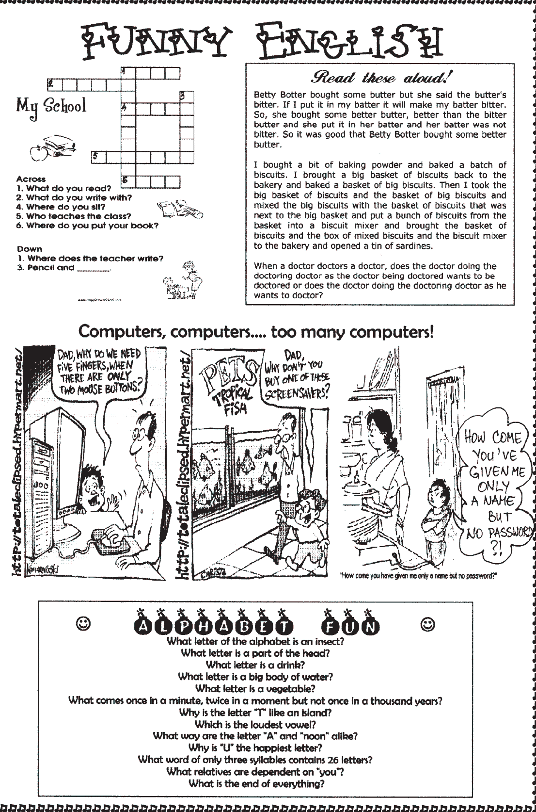
PAGES OF LAUGHTER AND ENTERTAINMENT

Slide 8
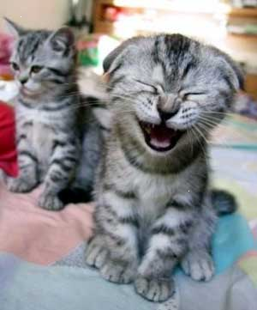
The Perfect Son.
A: I have the perfect son.
B: Does he smoke?
A: No, he doesn't.
B: Does he drink whiskey?
A: No, he doesn't.
B: Does he ever come home late?
A: No, he doesn't.
B: I guess you really do have the perfect son. How old is he?
A: He will be six months old next Wednesday.
A: Just look at that young person with the
short hair and blue jeans. Is it a boy or a girl?
B: It's a girl. She's my daughter.
A: Oh, I'm sorry, sir. I didn't know that you were her father.
B: I'm not. I'm her mother.

Slide 10
Fact or Fiction???
First four moves in chess you can play in 318.979.564.000 ways!
Once Charlie Chaplin won third place IN COMPETITION FOR HIS DOUBLE.
Boing 747 is longer than a first flight of famous Brothers Right!!!
ELEPHANTS ARE THE ONLY ANIMALS WHO CAN`T JUMP!
FISHING IS the MOST FAMOUS SPORT IN THE WORLD!
MEXICO CITY SINKS IN GROUND more than 25 CM each YEAR!
For 1 kg of honey bees must visit four millions of flowers!
Roman emperor Caligula declared HIS HORSE FOR SENATOR.
Prepared by Bora VII5

Slide 11
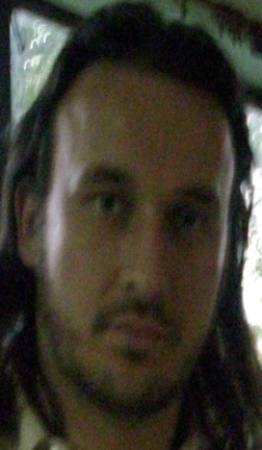
INTERviews The team of “Sweet Years” prepared for you interviews with two teachers of ours, Math teacher and English teacher. Read and find out something about them that you didn't’know and maybe you were afraid to ask.
SY: Where are you from and how old are you?
Teacher Misa: I’m from Novi Sad and I am 29.
SY: What would you do if you were not teacher? And why?
Teacher Misa: Chemistry teacher! Well….because I was more interested in chemistry. However, I liked Maths as well since there was more about computers, and I wanted that too so I gave up on chemistry
SY: Do you like you job in this school?
Teacher Misa: Of course, I like to work at school (primary).
SY: How long have you been teaching?
Teacher Misa: Three years with some pauses.
SY: Who do you get along with?
Teacher Misa: Mostly with everybody and I don’t have any problems.
SY: What makes you nervous in class? What about your colleges?
Teacher Misa: When students don’t listen to me and when they interrupt me with their questions before they think about what they want to ask.
SY: What kind of music do you listen?
Teacher Misa: Blues, rock, evergreen our music and foreign.
SY: Which film is your favorite?
Teacher Misa: The Lord of the Rings and Stephen King’s films.
SY: What was your biggest problem at school?
Teacher Misa: P.E. till 7th class and at high school philosophy, because I don’t like to learn by heart.
At school I was a big chubby and that was the reason why P.E. was my problem. When I started to play basketball my problem disappeared
SY: When did you have your first girlfriend/boyfriend?
Teacher Misa: I experienced first kiss when I was 13 and my first relationship…at 17.
SY: What was your biggest embarrassment at school?
Teacher Misa: Once, in 8th class I climbed up on my desk so I could drew pupils’ attention because they did not see I was already in.

Slide 12
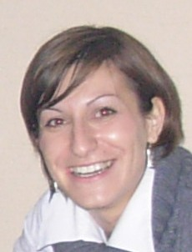
Know better our teacher of English!
SY: Where are you from and how old are you?
Teacher Mirela: I’m coming from all ex Yugoslav republic. and I’m 28
SY: What would you do if you were not teacher? And why?
Teacher Mirela: Music! Because it is my second love and I like to sing very much.
SY: How long have you been teaching?
Teacher Mirela: Five years. I was working at private schools in Novi Sad before getting a job in Curug.
SY: Who do you get along with?
Teacher Mirela: Well, at the begining I didn’t get along with anybody, but later with Branka, Danijela, Jelica…. I don’t really know the teachers from the opposite shift….
SY: What makes you nervous in class? What about your colleges?
Teacher Mirela: In class… when students don’t do their homework. Considering teachers…mmm…. nothing.
SY: What kind of music do you listen?
Teacher Mirela: I listen pop 80’s and heavy metal. It depends on the mood.
SY: Which film is your favorite?
Teacher Mirela: 18 again.
SY: What was your biggest problem at school?
Teacher Mirela: Maths.
SY: When did you have your first girlfriend/boyfriend?
Teacher Mirela: When I was 14.
SY: What was your biggest embarrassment at school?
Teacher Mirela: Once I ran away from a geography class because I didn’t prepare the unit very well and when I returned five minutes before the end of it the teacher called my name and asked me the unit. Bummer!!
At work, I am trying to be serious and mad but it is all funny to me so I sometimes start laughing .
prepared by Biljana, Radimla and Miroslava VII2

Slide 13
FILM: what you should watch and what you shouldn’t
Hancock
Hancock lives in LA. He is extremely strong but he is a wonderer and drunker. When he saves agent Rex’s life Rex decides to help him to be real and adorable superhero what is expected of him. The problem appears because Rex’s wife Marie has got the same power as Hancock has.
The roles in this comedy are given to Will Smith as Hancock, John Bitterman as Rex and Charlize Theron as Marrie. Film is directed by Peter Berg.
Translated by Snezana VII3

Slide 14
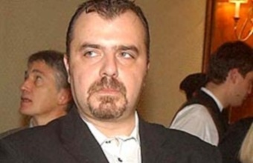
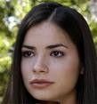
The fourth man The action of this film is happening in Belgrade. The man is waking up out of coma knowing nothing about himself. The BIA agent comes and finds out that he is a serial killer. He tries to find out who kill his family and who tried to kill him. “This is a new genre drama which is unusual for the Balkans” said Dejan Zecevic the director of the film who won many awards for this enterprise. Roles: Nikola Kojo as the main character, Marija Karan as Teodora, Bogdan Diklic as general Milankovic, the best friend of the main character Translated by Snezana VII3
T

Slide 15
I sitcoms desperate housewives
Four best friends live in a neighborhood. All four of them have love problems and with a lot of humor they are trying to solve them. The story starts when their fifth friend kills herself. They are trying to find the reason for that suicide.
Bree Van de Kamp: diligent wife and mother but her husband rex doesn’t respect her . her children are on their father’s side especially her son.
Lynette Scavo: had a successful career and she is a good business woman but she decided to be a mother and a housewife. She has four kids and she is trying to get to the end with her twins who are intolerable.
Susan Mayer: is divorced and she lives with her teenage daughter. She fell in love with a plumber, Mike but she has a problem with his past. Her daughter gives her a moral support whatever the problem.
Gabrielle Solis: is married to a wealthy businessman Carlos. She wants more excitement in her life and she finds that in the gardener John, but when her husband experiences deep financial problems she leaves John because she realized she loves her husband and she wants to help him but that littlie “adventure” of hers is going to cause deeper problems.
Translated by Snezana VII3

Slide 16
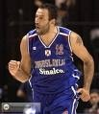
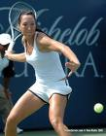
Play sport (not computer games)
In this section we will try to persuade kids to start training something by introducing them sports stars from all over the world. Will we succeed time will tell but still there is a hope that these text are not in vain.
In vain - uzalud

Slide 17
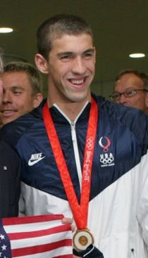
Michael Fred Phelps (born June 30, 1985) is an American swimmer. He has won 14 Olympic gold medals. He also holds seven world records in swimming. Phelps keeps the record for the most gold medals won at a single Olympics with the eight golds he won at the 2008 Olympic Games. With this record, he defeat Mark Spitz, who was also a swimmer. Phelps has won 16 Olympic medals: six gold and two bronze at Athens in 2004, and eight gold at in Beijing in 2008.. Out of his eight gold medals from Beijing, five were won in individual events. Phelps was born in Baltimore and grew up in the Rodgers Forge neighborhood. He graduated from Towson High School in 2003.[2] His father, Fred Phelps, worked for the Police and his mother, Deborah Sue "Debbie" Davisson Phelps, is a middle school principal.The two divorced in 1994.Michael, whose nickname is "MP", has two older sisters, Whitney and Hilary.Both of them were swimmers. In his youth, Phelps was very ill. He started swimming at age seven because of his sisters and because of his illness .When he was 10 he won a national record for his age group. In November 2004, at the age of 19, Phelps was arrested because he was driving drunk in Salisbury, Maryland. He pleaded guilty to driving while impaired the following month and was granted probation before judgment and ordered to serve 18 months probation, fined $250, obligated to speak to high school students about drinking and driving and had to attend a Mothers Against Drunk Driving (MADD) meeting.[6][7] Questioned about the incident later that month by Matt Lauer on the Today Show, Phelps said it was an "isolated incident" and that he had "definitely let myself down and my family down...I think I let a lot of people in the country down."[2] Between 2004 and 2008, Phelps attended the University of Michigan in Ann Arbor, Michigan, studying sports marketing and management. In May 2008, Phelps said he intends to return to Baltimore following the 2008 Olympics, joining Bob Bowman there when he leaves the University of Michigan, saying, "I'm not going to swim for anybody else. I think we can both help the North Baltimore Aquatic Club go further. I'm definitely going to be in Baltimore next year." The club has announced that Bowman is leaving the University of Michigan to become the club's CEO.[8] Phelps purchased a house in the Fells Point section of Baltimore, where he intends to reside after returning from the 2008 Summer Olympics.[9] His friends call him "Gomer" because he reminds them of Gomer Pyle, the good-natured, naïve country boy played by Jim Nabors on The Andy Griffith Show and Gomer Pyle, U.S.M.C..[10] He earns $5 million per year . After when he got his first million he used that money to create the Michael Phelps Foundation to help children teaching swimming PREPARED BY MARKO AND NEMANJA VII5

Slide 18
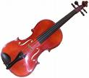
My favorites music instrument FAMILY OF VIOLINS
Violin got its today’s shape in the middle of 16th century together with cello and contrabass. During the next 2 centuries its shape developed to unique perfection.
Rich and strong sound of this family of instruments with a help of advanced playing techniques forced them to push back all other symphony instruments. Forming symphony orchestra and string quartets took over the leading role in classic music of western civilization.
Violine is widely use in folk music too, and contrabass in jazz.
Translated by Stevica and Dragana V1

Slide 19
Funny horoscope if you believe……believe
ARIES: you will get and E from sexual education. Your lucky day is 5th March.
TARUS: you will fall from motorbike. Your lucky day is 17th May.
GEMINI: your critical school subject is P.E. so be careful. Your lucky day is 14th January.
CANCER: Your life will end on a plate. Your lucky day is 15th June.
LEO: You will go to the concert of Tokyo hotel. Your lucky day is 25th July.
VIRGO: You will become a president of Germany. Your lucky day is 17th august.
LIBRA JOB: you’ll get a lot of money of you scratch your left palm.
LOVE: your big love is Santa Clause because he gives you a lot of presents.
TRAVEL: expect the journey to the mars. Your lucky date is 30th February.
SCORPIO: In the midnight you’ll become a vampire. Your lucky day is 31st October.
SAGITTARIUS: Your girlfriend/boyfriend is going to kill you. You will get fired. Your lucky day is 24TH March.
CAPRICORN: You’ll have and accident. Your lucky day is 2nd December.
AQUARIOUS: You’ll drown in the river Tisa. You don’t have lucky day.
PISCES: You are going to wash potatoes and that will be your job for life. Your lucky day is 27th April.

Slide 20
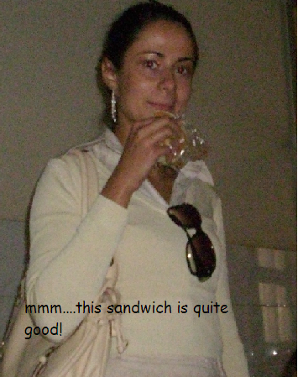
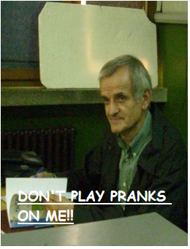
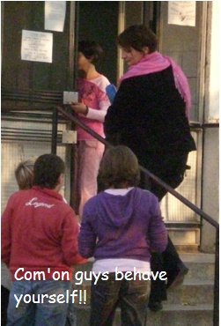
PAPARAZZO
,

Slide 21
Don’t be lazy, be popular!!
If you want to be popular in your school take a part in our educative game. What you have to do is to translate the following text in English. The student whose translation is the best one will be given a page in our magazine. He/She will be interviewed and photographed.
Eno je devojcica. Znam ja nju. Zove se Milena. Ima plavu kosu i najlepse plave oci. Tata joj se zove Slobodan, vrlo vredan covek. Zasto se ona meni toliko svidja? Da vam kazem, ne znam. Ali Milena je moja velika ljubav jos od prosle godine. I tako ja gledam u nju a ona mene……. i ne primecuje. Sedi na zidicu sa svojim drugaricama i nesto razgovaraju. Mozda pricaju o meni? Ah, to bi bas bilo dobro, da sam ja njihova glavna tema. Ma, nema veze. Ko zna sta sve moze da se desi. Imam ja jos vremena da nadjem svoju srecu, imam ja jos vremena da nadjem drugu plavu, smedju, crnu kosu i najlepse oci, bilo koje boje da su. Da, jos sam mlad.

Slide 22
This magazine exists thanks to:
Biljana Miletic
Miroslava Ivanov
Radmila Topalski
Snezana Đoric
Dragica Ćurčin
Branka Mrkšić
Nemanja Dobanovacki
Marko Ivkov
Borislav Stojsin
Sara Lapadat
Ksenja Stajic
Marija Cvjetkovic
Stevica Mitrovic
Dragana Arsin
We also want to thank teachers who were willing to answer our interview questions and teachers whose photos you can see on the PAPARAZZO page.

